Slide 1
BUILDING VISUAL MAPS FROM IMAGE SEQUENCES SENT From MAV
Jashwanth Reddy

Slide 2
VISUAL SLAM
Assumptions:
Indoor Navigation
No GPS sensor attached
Camera is the only primary sensor(sonar may be present)
Primarily three types of indoor environments.
Corridors
Staircase
Open Space

Slide 3
VISUAL SLAM
Different SLAM algorithms can be applied to each environment
Traditional Outdoor navigation like providing a set of way points for robot is not possible in indoor navigation.

Slide 4
Challenges with Indoor Navigation
Understand the scene from image taken and navigate further.
Avoid collisions with obstacles.
So it’s very important to build map for indoor navigation .

Slide 5
Maps
What kind of maps we can build from the image data????
Panorama!!!! Well next few slides I will discuss about building a larger view of images by stitching them.
Depth maps
Point Clouds
Volumetric Models

Slide 6
How to we build panorama
Panoramic photography captures images with elongated fields of view.
My algorithm:
Find SIFT features of each image
Perform matching test with the distance ratio method.
Find the homography between the two images.
Finally blend the two images to form large view.

Slide 7
Finding Homography
Homography H is a 3 × 3 (non-singular) matrix defined only upto scale. It has 8 degrees of freedom and can be estimated from 4 world points for which image points in both views are known. Each such point gives 2 equations.
Use Ransac to find the best matches.

Slide 8
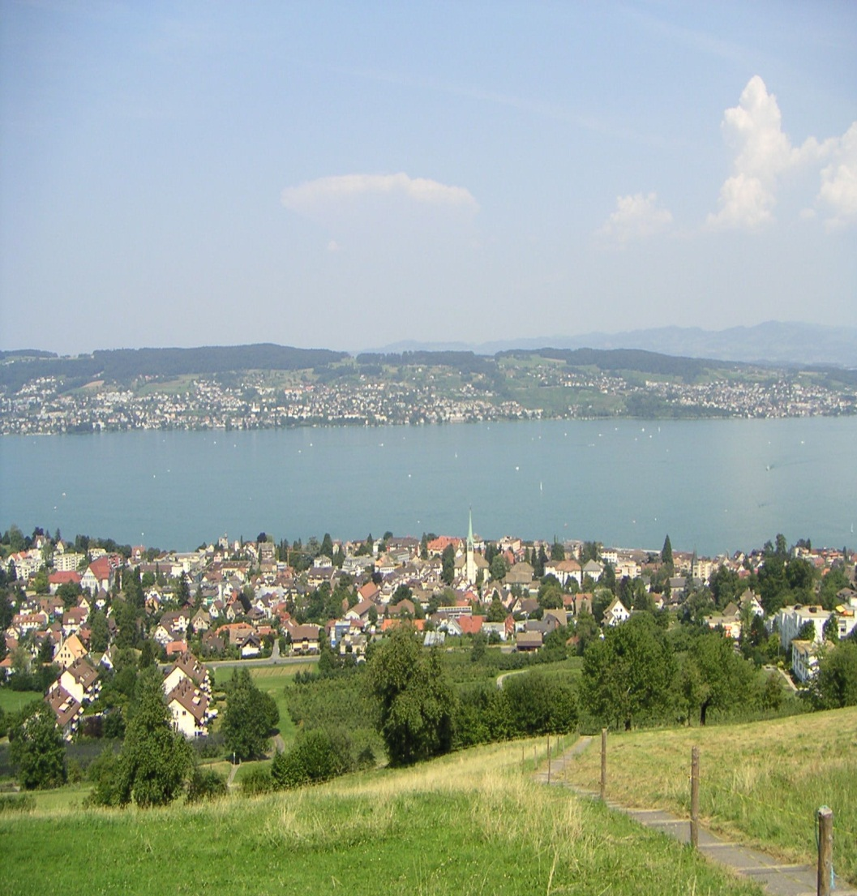
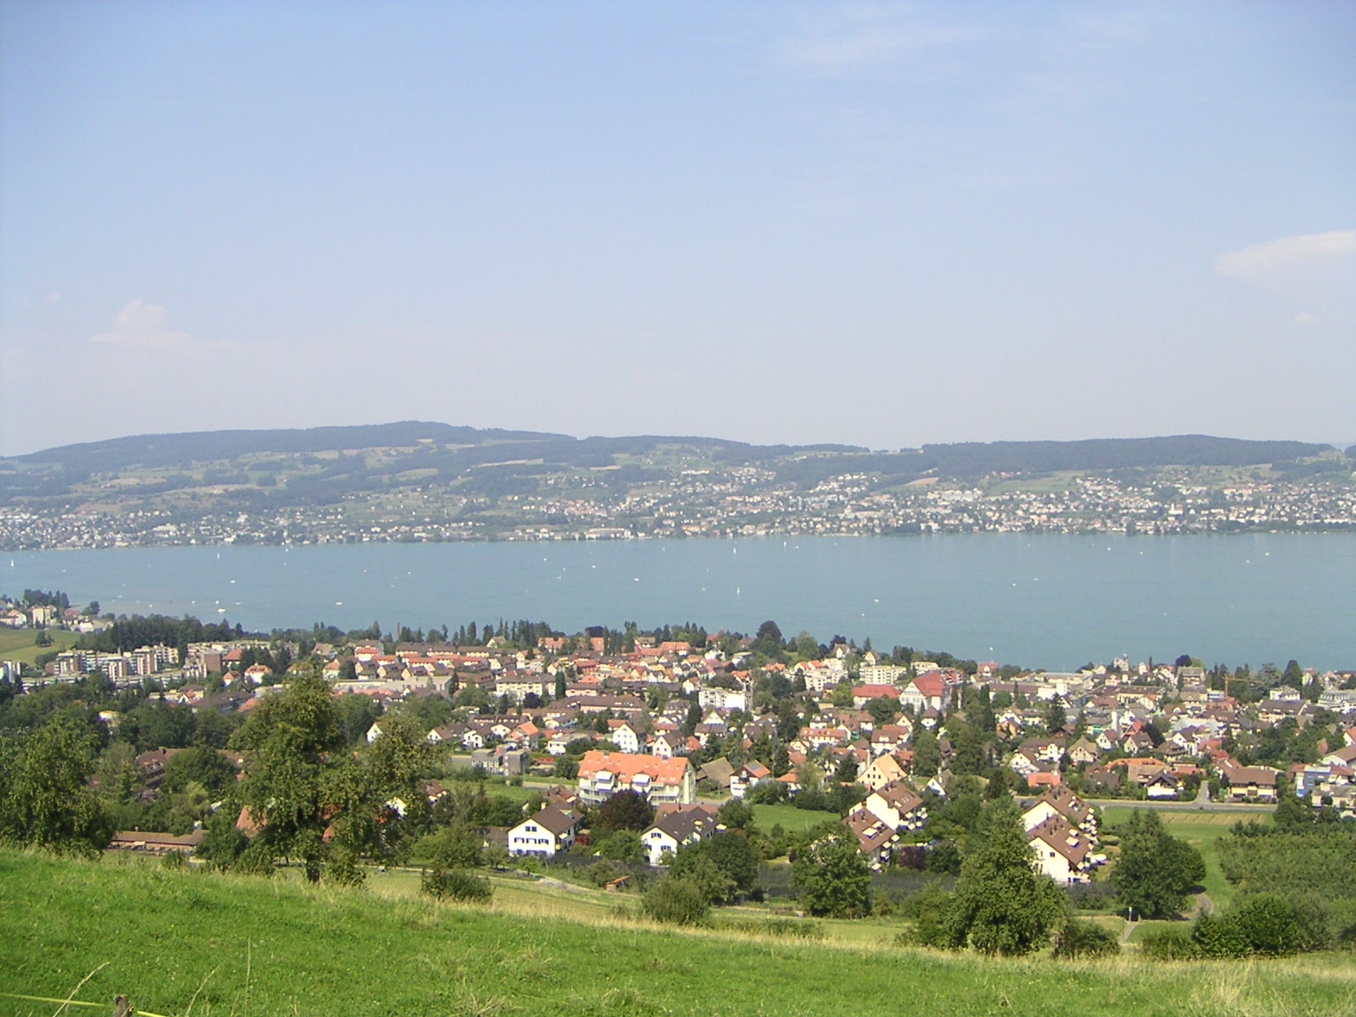
Panorama

Slide 9
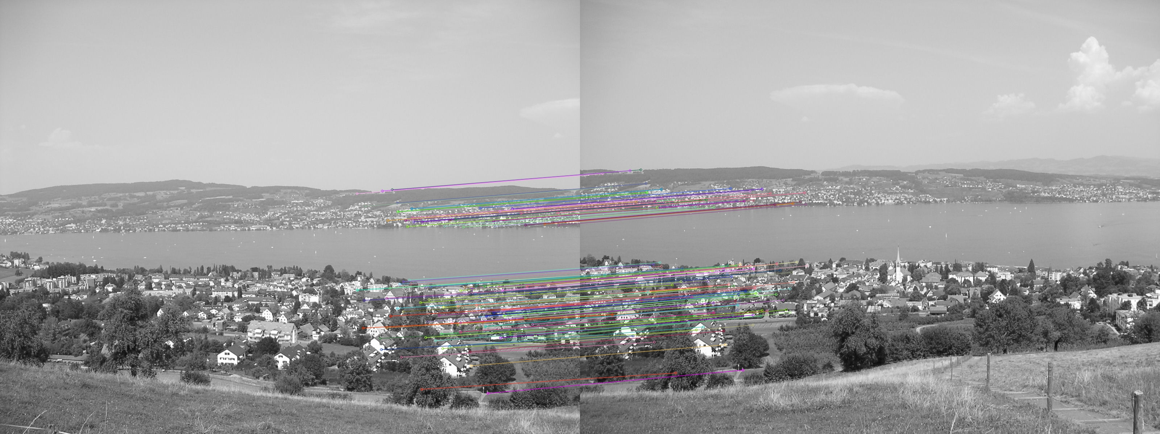
Matching Between Images

Slide 10
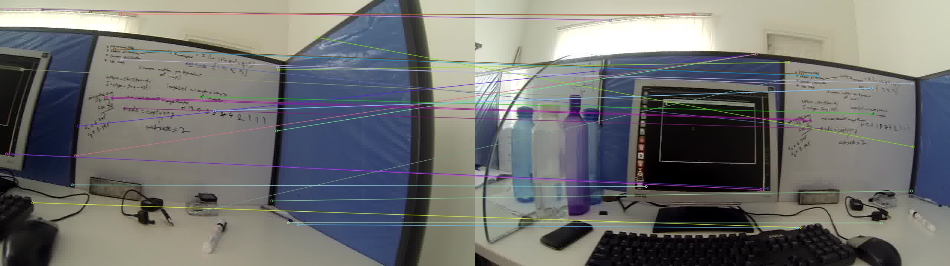
Matching between images

Slide 11
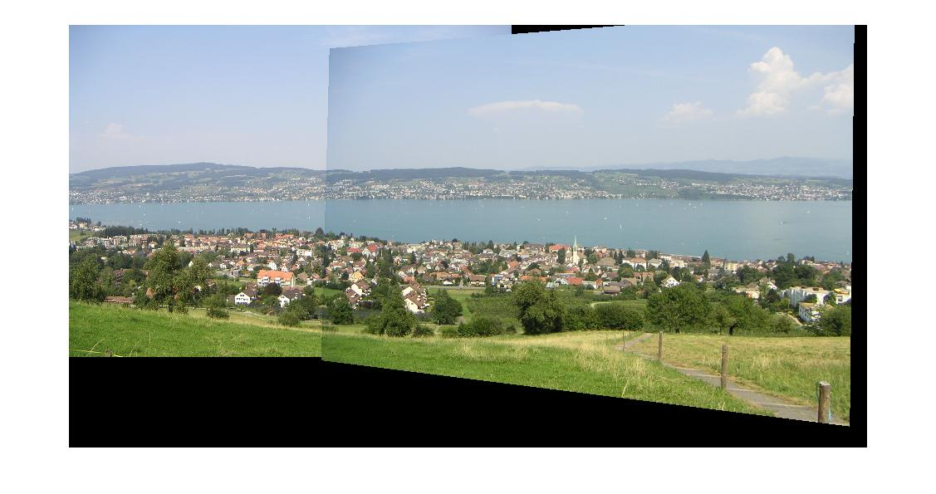
Stitched Image

Slide 12
How good is panorama??
We cannot rely upon panorama completely.
Depth information is not much known.
3D structure of scene cannot be concluded which is important in indoor navigation.

Slide 13
Other methods:
Preview from internet:
Stereo Vision : Given several images of the same object or scene, compute a representation of its 3D shape
Structure from motion techniques : Given m cameras
and n points and projections xij of point j in camera
i recover 3D points and camera matrices Ci.
Bundle Adjustments :

Slide 14
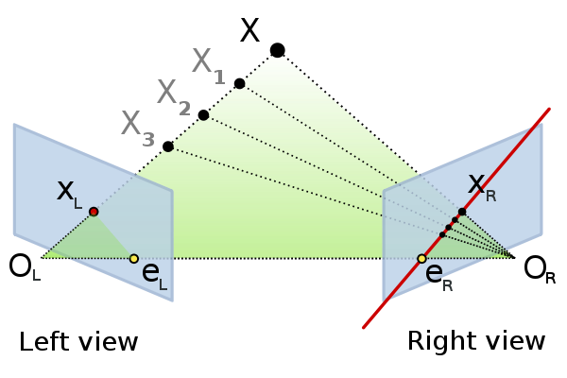
Fundamental Matrix
Fundamental matrix is found from point matches using 8 point algorithm .
Fundamental matrix is property of camera pair and is independent of scene.

Slide 15
Fundamental Matrix
P1 = [ I|0] and P2=[e’ * F[e’]] have the fundamental matrix F.
P1*H and P2*H also have same fundamental matrix. Where H is homography of 3*3 space.

Slide 16
Stereo Vision
Identify common points
Constraints on matching:
Match lies on epipolar line of pixel.
Uniqueness : A point in left image matches with unique point in right image.
Ordering: Point A lies to the left of B in all the views.
Perform rectification.

Slide 17
SFM
Given m cameras and n points and projections xij of point j in camera i, recover 3D points Xj and camera matrices C_{i} .
Find a world point in two or more views.
F can be decomposed into cam matrices [I|0] and [M|m]
(x,x’) Rays through them meet at 3D point. But with projective ambiguity. Affine Metric

Slide 18
SFM continued…..
Suppose we track P feature points over F frames in an image stream. Let the trajectories of image coordinates be (ufp; vfp) where f = 1, 2,….F and p = 1, 2,..P.
All the problems of structure from motion problems reduce to factorising this matrix into RS where R is the rotation matrix and S is the shape matrix.

Slide 19

Bundle Adjustment
Bundle adjustment amounts to jointly refining a set of initial camera and structure parameter estimates for finding the set of parameters that most accurately predict the locations of the observed points in the set of available images.

Slide 20
In order to obtain a 3D model you need to provide both the radially rectified images and the internal calibration parameters (the matrix K).

Slide 21
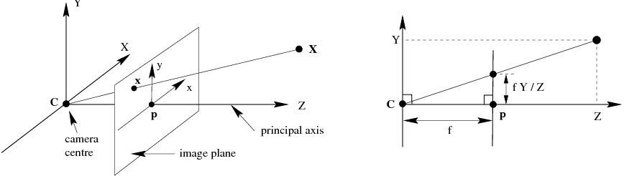
Calibrating Camera
Camera is modelled as pin-hole camera as follows:

Slide 22

Calibrating Camera
Our aim is to find internal camera matrix and distortion coefficients.
Skew coefficient = 0 and aspect ratio =1

Slide 23
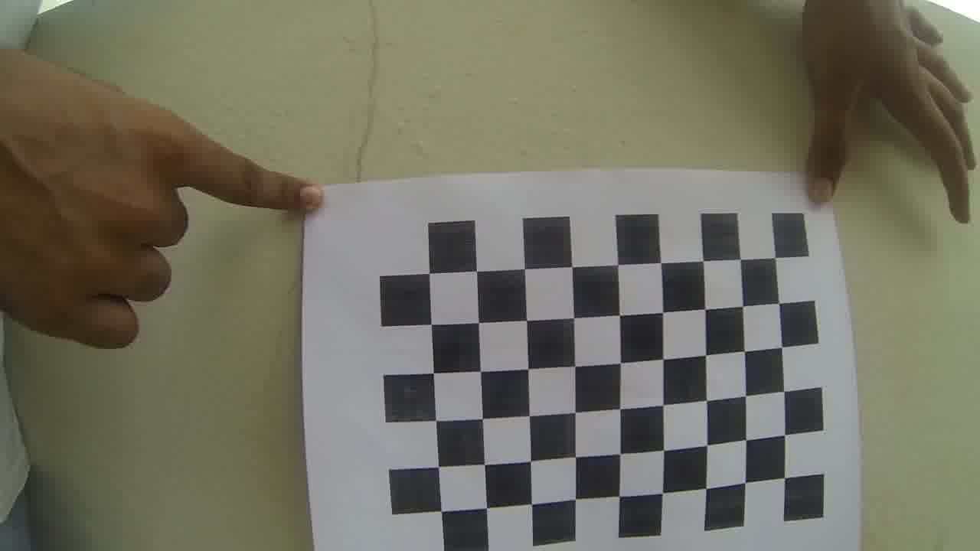
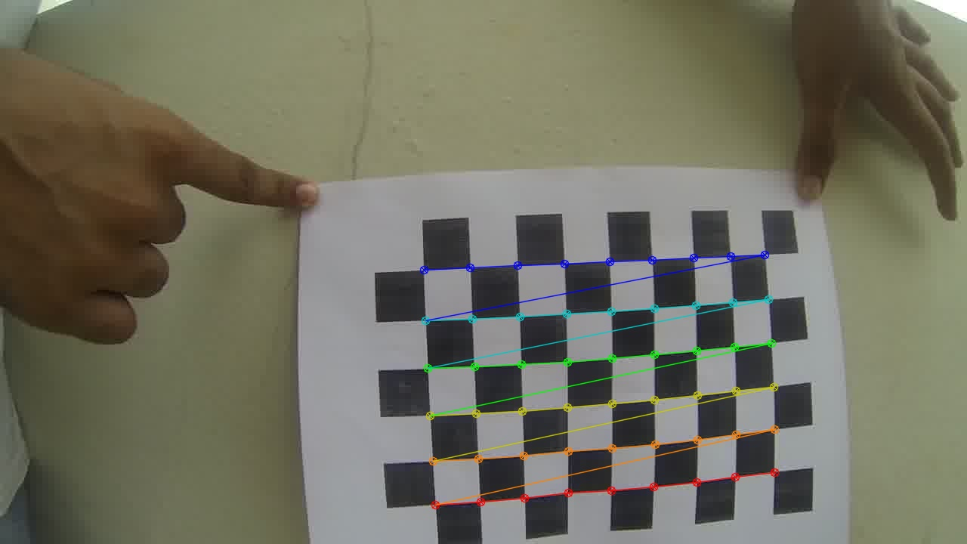
We use chessboard corners for calibrating the camera.

Slide 24
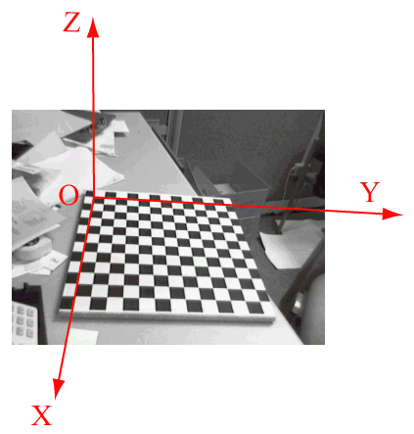

Extrinsic parameters
x = K[R|-RC]Xw

Slide 25

Calibrating Camera
Old point pixel (x,y) and corrected output image its position in pixel (xcorr,ycorr) are related as

Slide 26
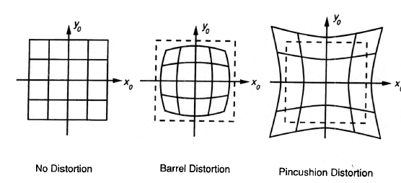
Distortion in Images
Image magnification decreases with increase in distance from principal axis.
Straight lines appear curved.

Slide 27
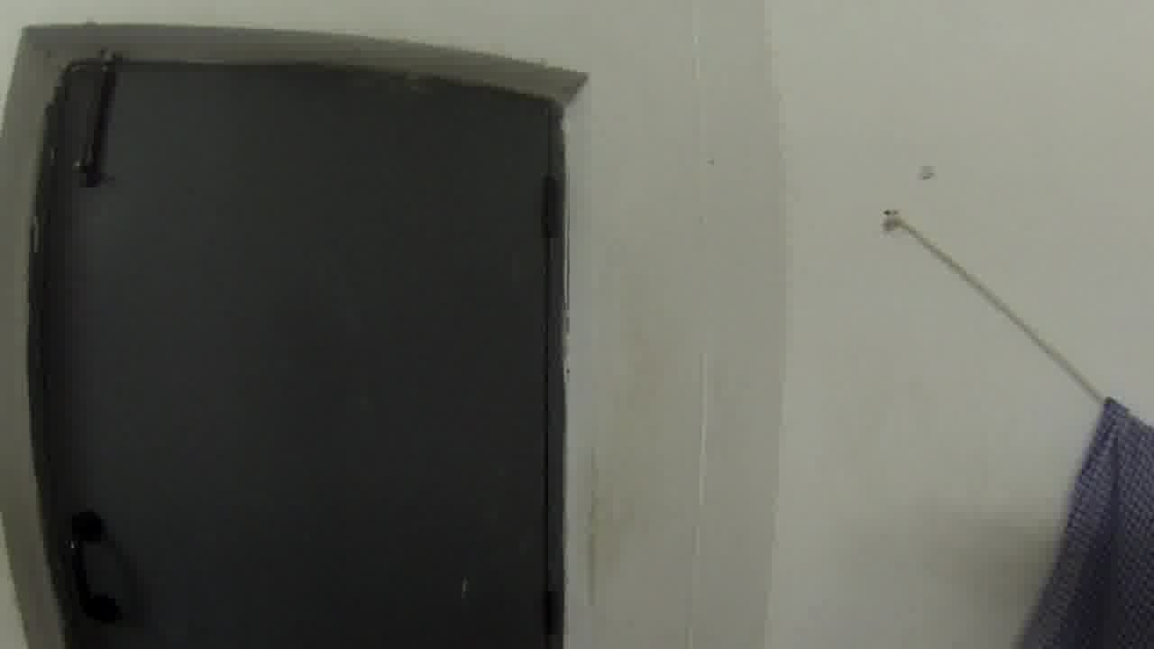
Image with Distortion

Slide 28
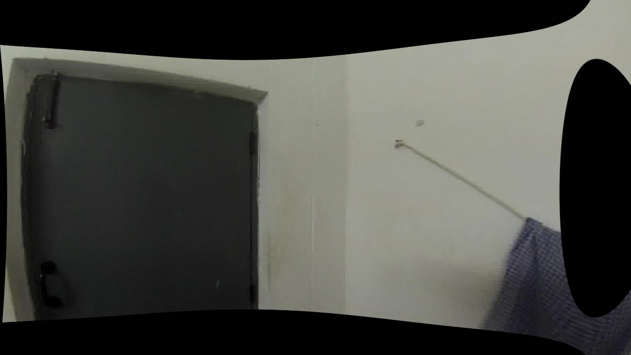
Distortion Removed

